Slide 1

Build Spider on Cloud
Workshop presented by Hall 2 IT team

Slide 2
Get started
This workshop is given in Python 2, if you wish to work in your local pc, please make sure you’ve have following modules installed:
selenium
phantomjs
requests
BeautifulSoup4
Jupyter Notebook
If not… we’ve prepared a server for you to log in with, you just have to follow the steps in next few slides

Slide 3
Steps for environment setup
“https://drive.google.com/open?id=0Bx06sggvEI3MYnpCM2doYWM4c0k”
Download the key depending on your Operating system
Windows : window_key.ppk
Mac : mac_key.pem
Please open the google form within the folder, we would post commands, url to you interactively.

Slide 4
Mac User
Open terminal
type in command:
ssh -i [path to the downloaded key] -f [your user name]@[IP address to the server] -L 1234:localhost:1234
Open browser and access page “localhost:1234”
Go to your folder according to your user name

Slide 5
Windows user
Download putty.zip in the google share folder
Open CMD and go to the path containing plink.exe
Type in Command
plink -i [path to your key] -L 1234:localhost:1234 [your user name]@[server IP address]
Open browser and access page “localhost:1234”
Go to your folder according to your user name

Slide 6
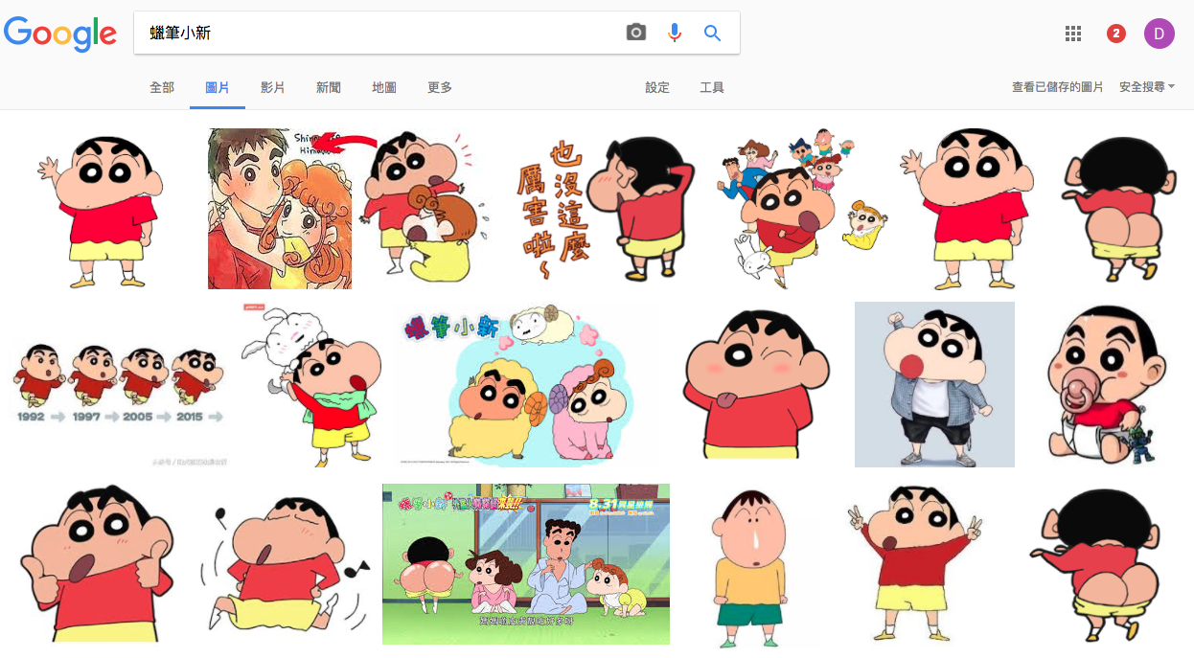
Have you ever come to ...
BUT, right click to save all images are just too tedious
Notes:
a situation that you want to download large amount of images

Slide 7
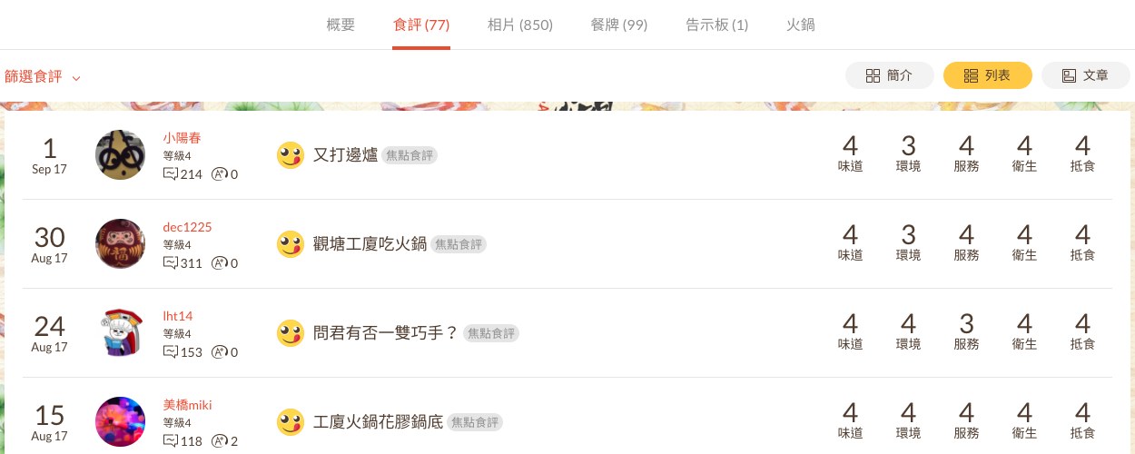
Or you wish to collect the rating of a store
There are hundreds of them, still tedious...
Notes:
or you want to save the ratings of a restaurant for further used

Slide 8
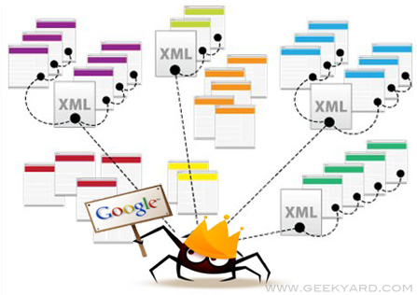
What is Spider / Crawler / Scaper ?
Extract useful information (e.g. text, images) directly from the source of website
Notes:
In all those cases, collecting data manually would be dull and boring, therefore, we need help from spider, which is basically a set of code help you to retrieve those needed data

Slide 9
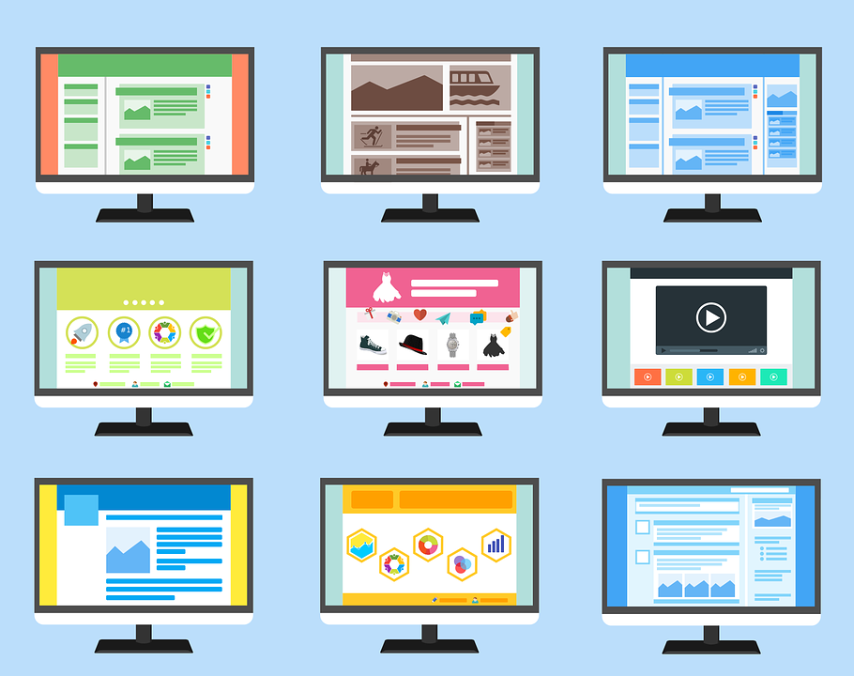
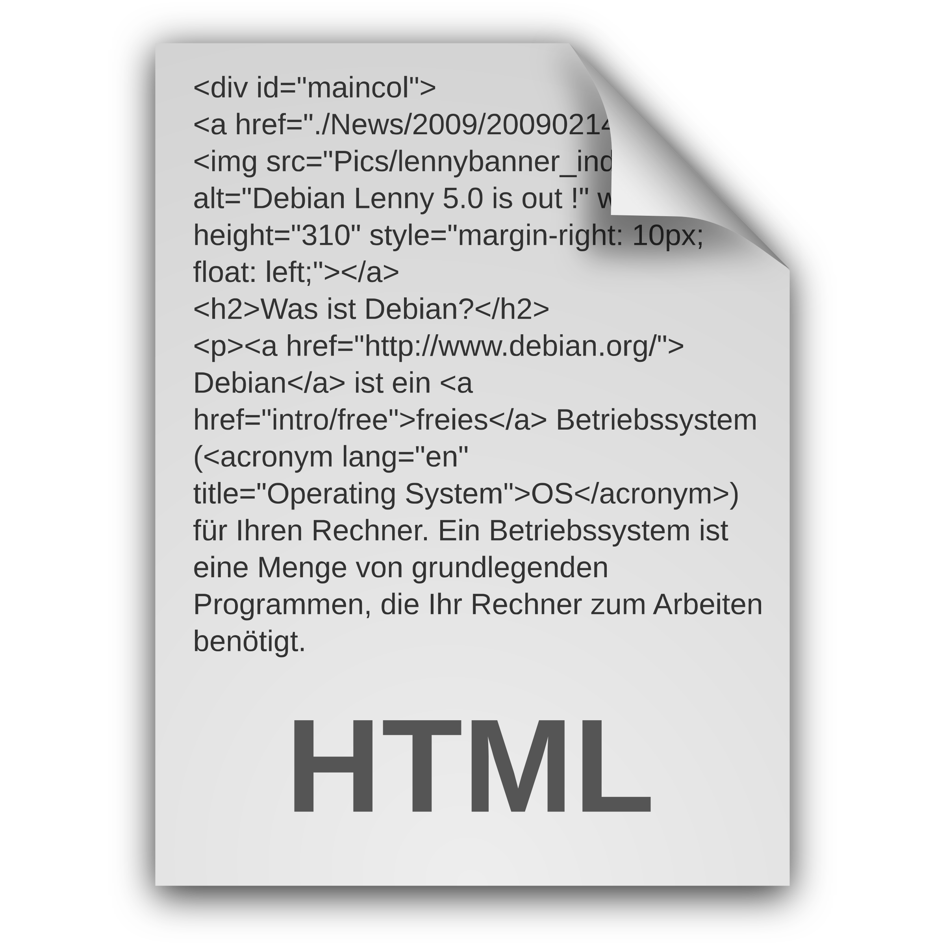


How browsers render websites
Browser
Server
Request
Notes:
explain the process of rendering a webpage and bring out the topic of html code

Slide 10
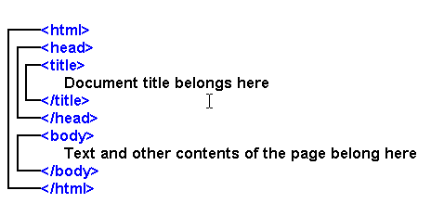
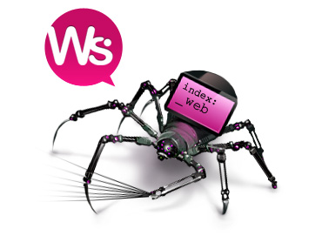
How a spider works?
Server
Request
Notes:
Spider directly look at the source of website and retreive needed information

Slide 11
Brief Introduction on HTML code
Hypertext Markup Language (HTML) is the main language for writing webpages.
<tag> and examples
HTML Attributes

Slide 12
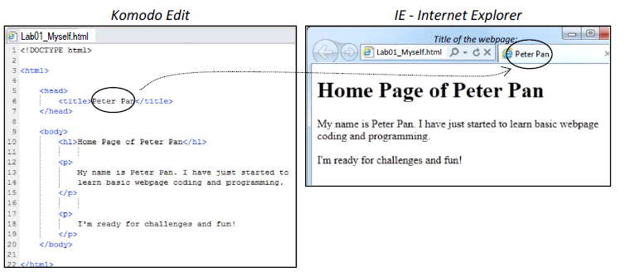
Tags
In an html file, all html contents are enclosed between the start and end tags.
<html> </html>

Slide 13
Head section and body section

Slide 14
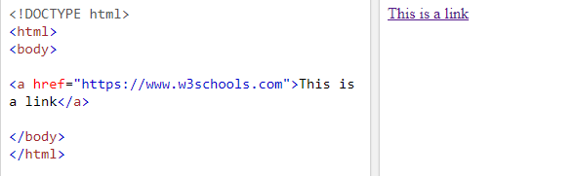
<h1></h1>
<p></p>
<a></a>
We can add a hyperlink using the <a> element.
To specify a web address, we provide the reference attribute href=".." in the start tag <a >.

Slide 15
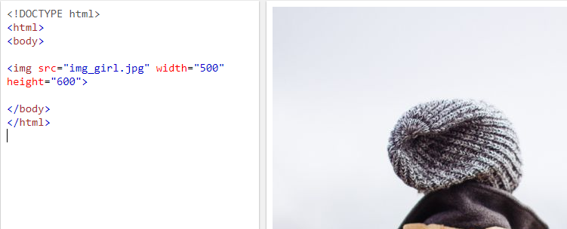
<h1></h1>
<p></p>
<a></a>
<img></img>
HTML images are defined with the <img> tag.
The filename of the image source is specified in the src attribute:

Slide 16
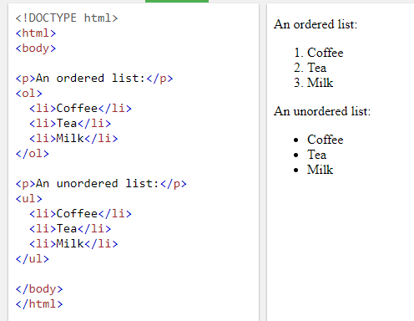
<h1></h1>
<p></p>
<a></a>
<img></img>
<li></li>
The <li> tag defines a list item.
The <li> tag is used in ordered
lists(<ol>), unordered lists (<ul>),
and in menu lists (<menu>).

Slide 17
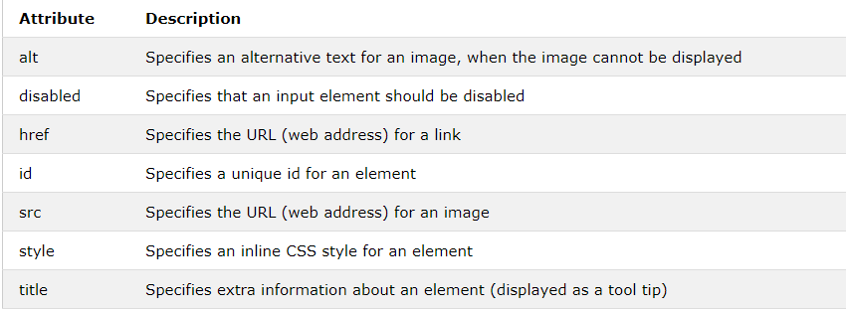
HTML Attributes

Slide 18
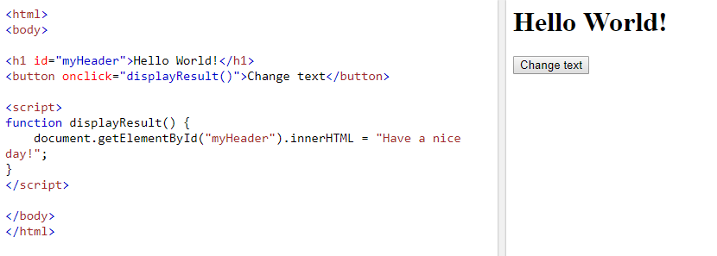
id

Slide 19
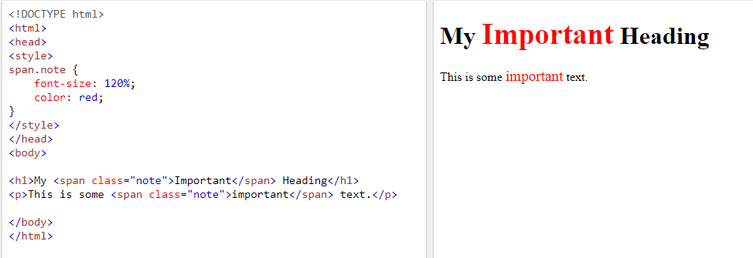
Class
The HTML class attribute makes it possible to define equal styles for elements with the same class name.

Slide 20
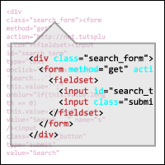
How we extract information from those raw sources?

Slide 21
What is Regular Expression?
Abbreviated as “Regex”
A sequence of symbols and characters used for pattern-matching
Useful for extrating information from text, such as email address, html tags, url…
Widely applicable in different programming languages
Regular Language
Chomsky Hierarchy Context-free Language
(4 types of formal language) Context-sensitive Language
Unrestricted Language
most restricted

Slide 22
Regex Cheatsheet!
Character Classes | Groups & Lookaround | Quantifiers & Alternation
. any character except newline \w \d \s word, digit, whitespace \W \D \S not word, digit, whitespace [abc] character set (any of a, b, c) [^abc] negated set (not a, b, c) [a-g] range (any between a- g) | (abc) capture group \1 back-reference to group 1 (?:abc) non-capturing group (?=abc) positive lookahead (?! abc) negative lookahead | a* 0 or more a+ 1 or more a? 0 or 1 a{3} match exactly 3 a{3,} match 3 or more a{1,3} match between 1 to 3 a+? match as few as possible (lazy) a|b match a or b
Escaped Characters | Anchors | Flags
\. \* \\ escaped special characters \t \n \r tab, line feed, carriage return | ^abc start of a string abc$ end of a string \b word boundary \B not word boundary | re.I ignore case re.M multiline re.S dot matches all including newline
Reference website: https://regexr.com

Slide 23
Regex in Python
re.findall: return all matches as a “list” of strings
re.search: scan for the first match, return MatchObject or None
re.match: match at the beginning of the string, return MatchObject or None
re.findall/search/match (pattern, string, flag=0)
re.compile: compile the pattern in a “regex object”, convenient for repeated use
prog = re.compile (pattern)
result= prog.findall/search/match (string)

Slide 24
Work through in Jupyter notebook
Work them through the whole code and explain line by line
user-agent
header
dynamic webiste with javascript
exception handling
crawling
requests
received data
parse the raw source with a) regular expression b) packages BeautifulSoup4
write the data to file
scp back the image and document for examination

Slide 25
Summary
Even though spider is COOL, we shouldn’t consider using spider in the first place, very often there are grouped packages, api, or tools for you to download data. You only use spider when there’s no other choice
Website are constructed by human, therefore, there must have some logic in it and we should build our spider case by case.

Slide 26
Build your own crawler base on the given example
Try Yourself ~
Notes:
tell them to find a website themselves and try to adapt the given code and crawl back some information

